Slide 1


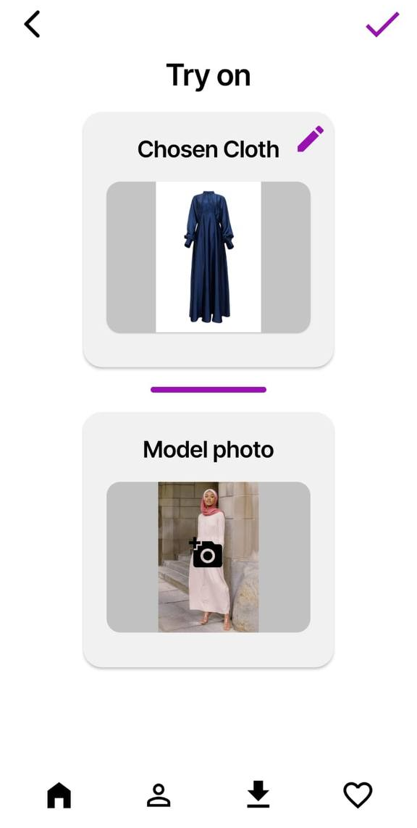
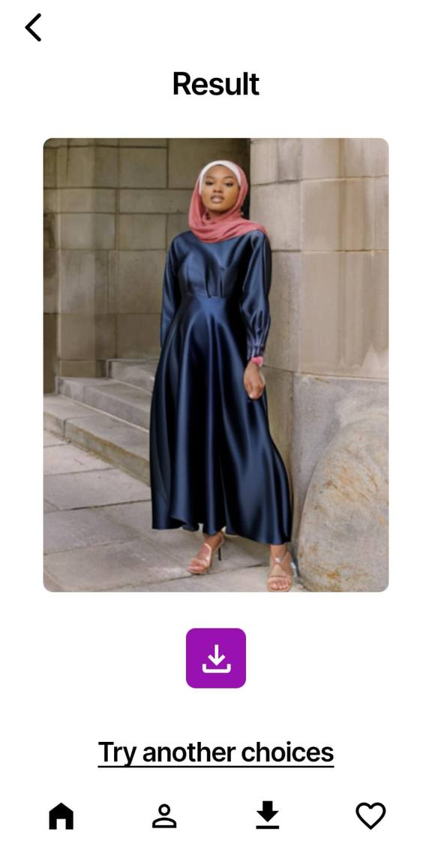
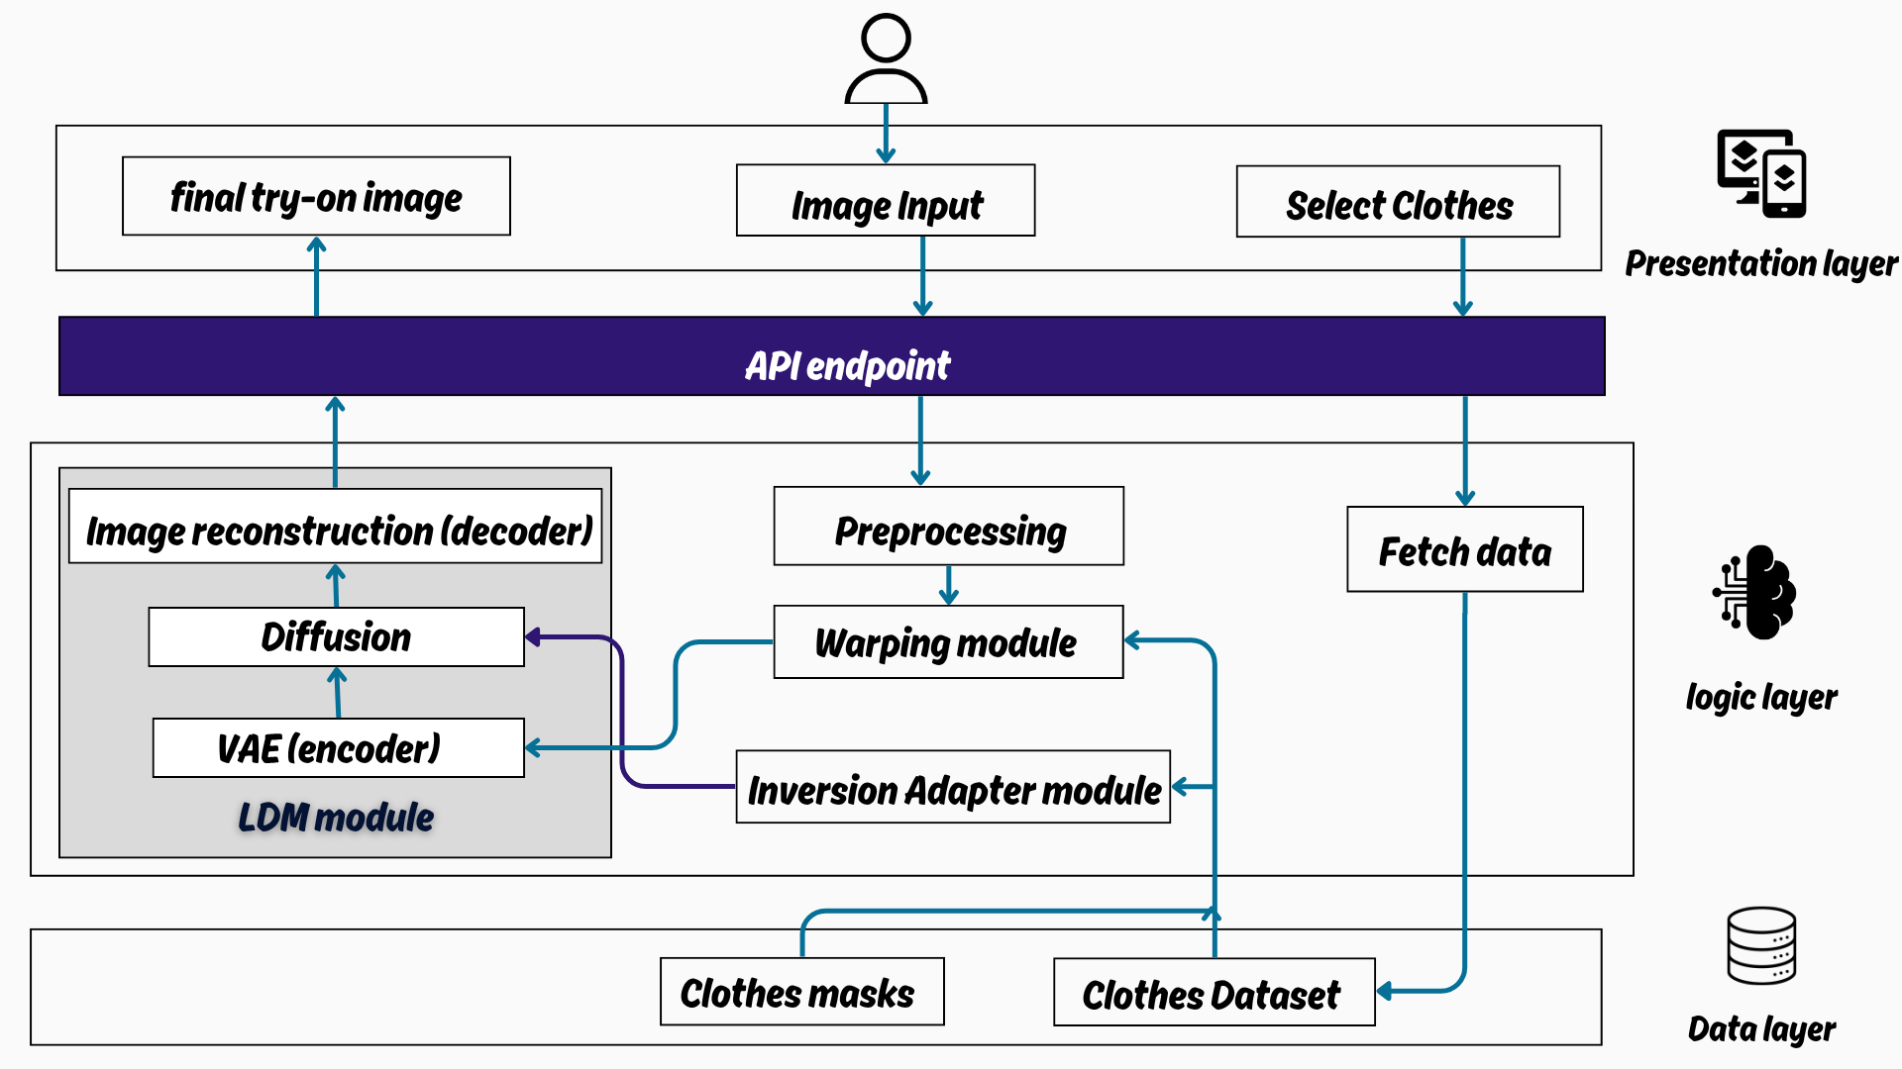
VTON Egyptian Brands
By: Genyveyav Raafat, Hassnaa Hassan, Habiba Mohammed ,
Toqa Osama, Monica Adel, Maria George
Supervised by: Prof. Dr. Abeer Mahmoud , TA.Mohamed Essam
Faculty of Computer and Information Sciences - Ain Shams University
Introduction
Phase 3: Diffusion Synthesis
LaDI-VTON: Latent Diffusion Model (LDM) synthesizes outputs conditioned on:
Warped garments + masks
Pose maps + CLIP embeddings
VAE Decoder: Generates 1024×768px photorealistic images.
3. Data Layer (Firebase)
Storage: Clothing categories (Upper, Lower, Full) and user try-on histories.
Authentication: Secure login/profile management.
In Egypt’s booming e-commerce market, online shoppers—especially veiled women—face challenges in visualizing how clothing fits and aligns with modesty standards. Traditional virtual try-on (VTON) systems often lack support for hijabs, layered garments, and regional fashion preferences, leading to higher return rates and reduced customer satisfaction.
TryFit bridges this gap by leveraging advanced AI (LaDI-VTON architecture with CLIP embeddings and latent diffusion models) to deliver realistic, modesty-aware virtual try-ons. Our solution features:
Pose-aware garment warping and hijab-preserving synthesis for culturally respectful results.
A curated dataset of Egyptian modest wear, including veiled and unveiled models.
An user-friendly interface for Normal users and Providers.
By combining computer vision innovations with local fashion needs, TryFit empowers users to shop confidently while supporting Egyptian brands.
Results
Modest-First Virtual Try-On: Achieved hijab preservation accuracy during garment synthesis
Photorealistic Outputs: FID Score: 53.283 (vs. 61.87 for LaDI-VTON)
Local Impact: 60% Egyptian modest wear in dataset
Table I: Results of TryFit
Accuracy | LaDI-VTON model | Our model | Effective Parameter
FID ↓ | 61.87 | 53.283 | Fine-tuning with custom data
LPIPS ↓ | 0.183 | 0.140
SSIM ↑ | 0.817 | 0.868
Methods
A Culturally-Aware Virtual Try-On Pipeline
Figure 1: System Architecture
As shown in Figure 1, TryFit’s modular architecture automates realistic virtual try-ons through a three-layer workflow, optimized for modest fashion:
1. Presentation Layer (Flutter UI)
User Interaction:
Upload full-body photos via gallery/camera.
Browse categorized clothing (Upper/Lower/Full) with hijab-friendly filters.
Output: Displays try-on results with download option.
2. Logic Layer (Flask API + AI Core)
Phase 1: Preprocessing
Human Parsing: SCHP segments body regions (hijab, skin) for modesty preservation.
Pose Estimation: OpenPose extracts 18 keypoints for anatomical alignment.
Cloth Masking: Grounded-SAM generates precise binary masks for garment isolation.
Phase 2: Garment Alignment
TPS Warping: Aligns clothing to user pose using keypoints and masks.
EMASC Refinement: Mask-aware skip connections enhance edges (e.g., loose sleeves, hijab draping).
CLIP Embeddings: V⋆ tokens encode garment semantics (texture, style).
Figures 2 , 3: Sample of virtual try-on results
Conclusions
TryFit successfully bridges the gap in virtual try-on technology for modest fashion by supporting hijab and layered garment synthesis. Using AI-driven garment warping and cultural segmentation, it delivers realistic, pose-aligned try-on results. The system enhances user confidence, reduces return rates, and promotes local Egyptian fashion through an inclusive and user-friendly platform.
Bibliography
[1] D. Morelli, A. Baldrati, G. Cartella, M. Cornia, M. Bertini, and R. Cucchiara, “LaDI-VTON: Latent Diffusion Textual-Inversion Enhanced Virtual Try-On,” Oct. 2023, doi: https://doi.org/10.1145/3581783.3612137.
[2] GoGoDuck912, “GitHub - GoGoDuck912/Self-Correction-Human-Parsing: An out-of-box human parsing representation extractor.,” GitHub, 2019. https://github.com/GoGoDuck912/Self-Correction-Human-Parsing (accessed Feb. 15, 2025).
[3] Hzzone, “GitHub - Hzzone/pytorch-openpose: pytorch implementation of openpose including Hand and Body Pose Estimation.,” GitHub, 2018. https://github.com/Hzzone/pytorch-openpose.git (accessed Feb. 21, 2025).
Order online at https://www.postersession.com/order/

